Slide 1
Lunch & Learn: HTML 5 CSS 3
INTRODUCTION
TO WEB PROGRAMMING

Slide 2
What we will talk about:
Front-end vs Back-end coding
Defning HTML, CSS and Javascript
How the client stylesheets work
Examples
Tools

Slide 3






Slide 4
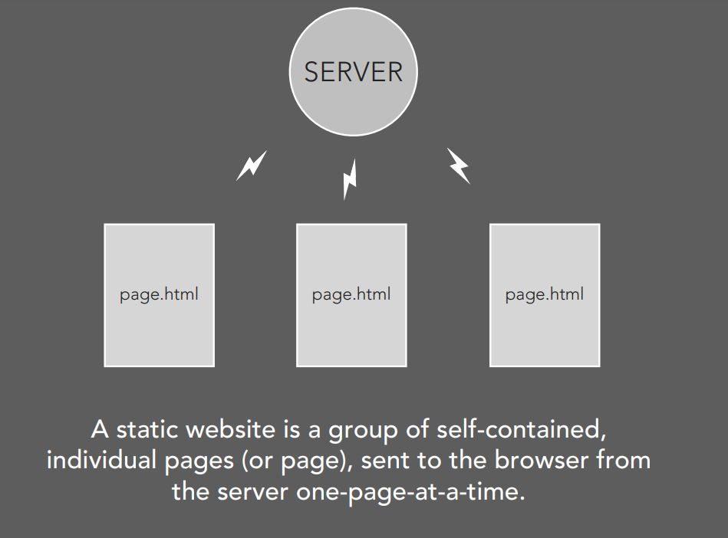
INTRO TO WEB PAGES
Static Pages

Slide 5
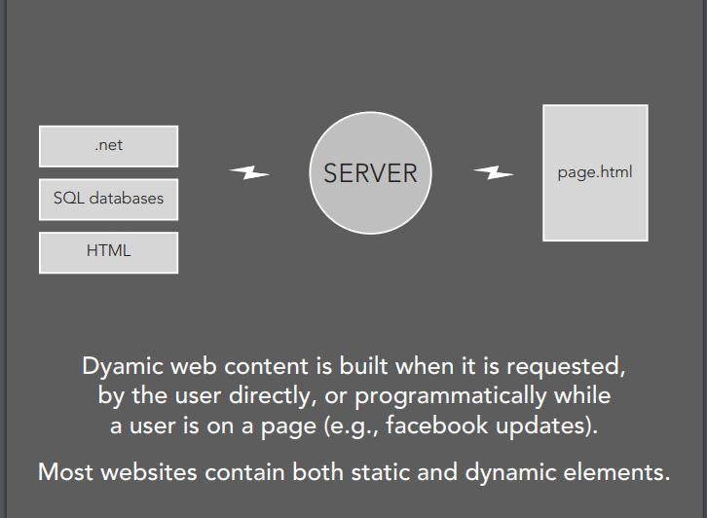
INTRO TO WEB PAGES
Dynamic Pages

Slide 6
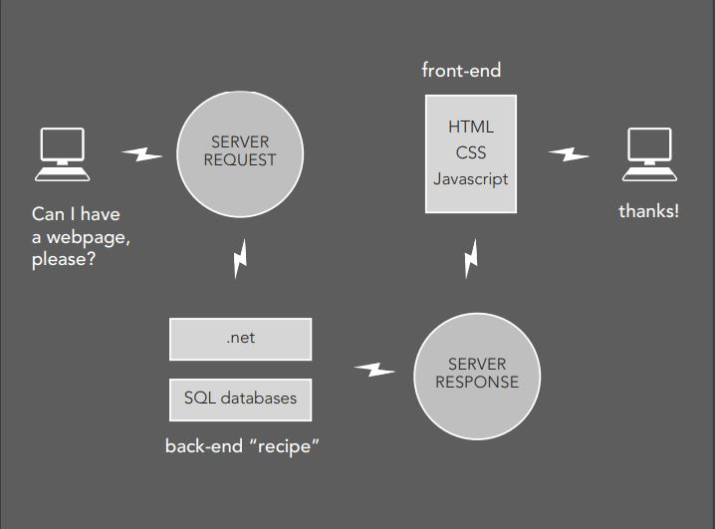
WEB STRUCTURE :

Slide 7
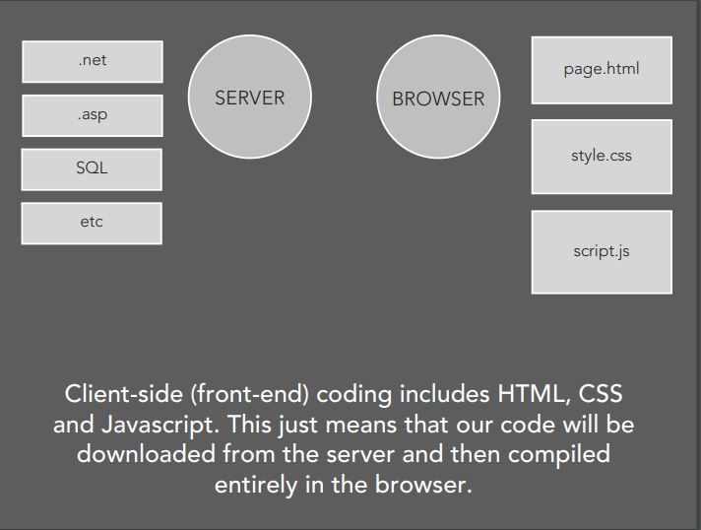
Server-side / Client-side :

Slide 8
Getting Started ………
HTML, CSS, Javascript

Slide 9
Start Building Applications
Three layers of web design:
Structure
Style
Behavior

Slide 10
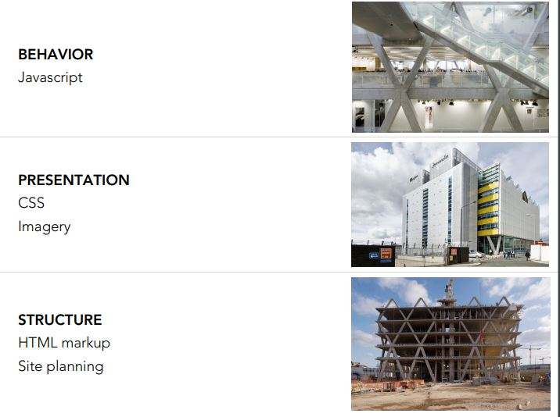

Slide 11
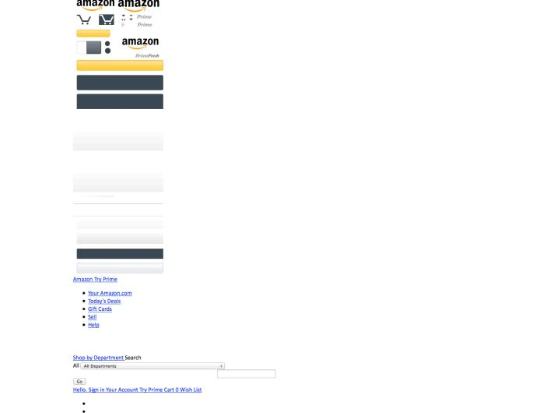
Amazon :

Slide 12
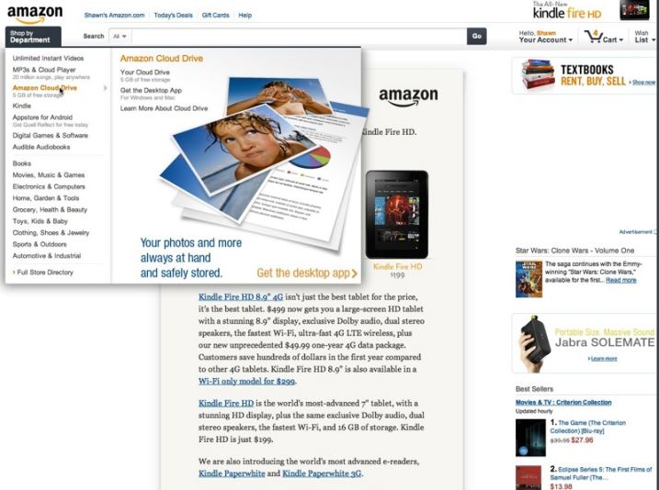
Amazon :

Slide 13
Projects We Made
A Tribute Page
Survey Form
Technical Documentation Page
Restaurant Web Page
Portfolio Page
Google Landing Page
BBC News Web Site

Slide 14
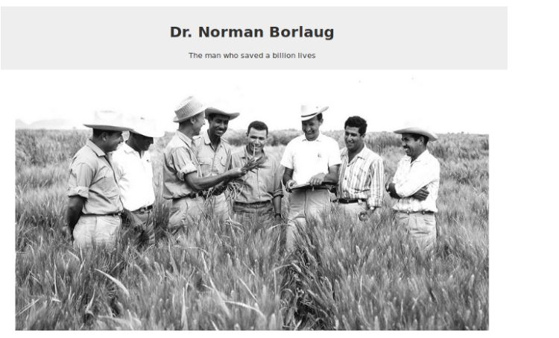
A Tribuite Page

Slide 15
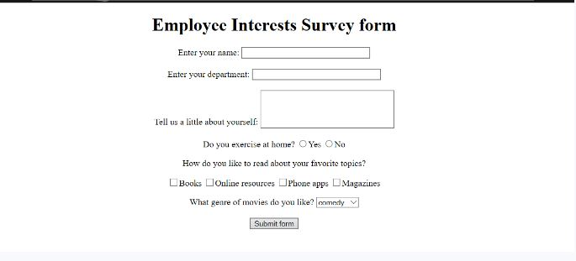
Survey Form

Slide 16
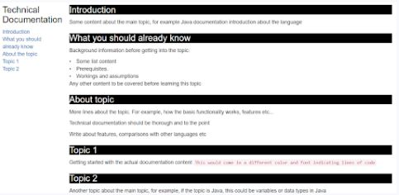
Technical Documentation Page

Slide 17

Restaurant Web Page

Slide 18
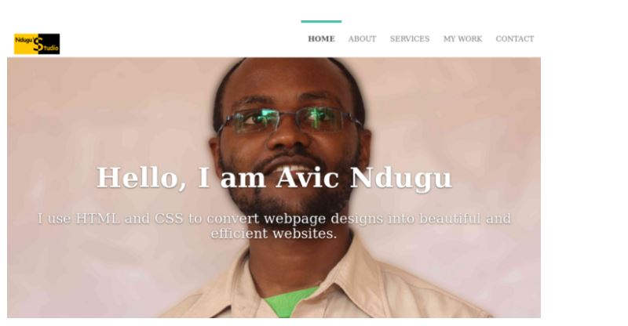
Portfolio Page

Slide 19
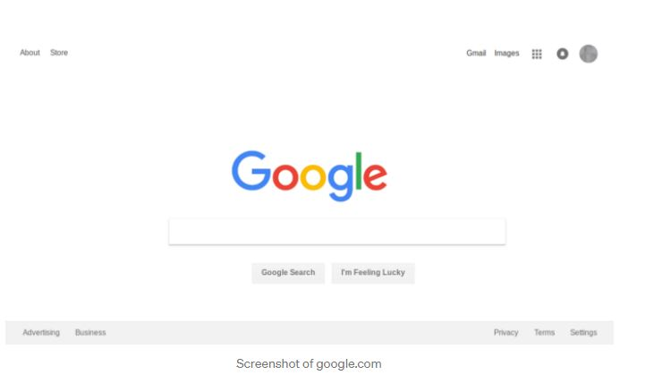
Google

Slide 20
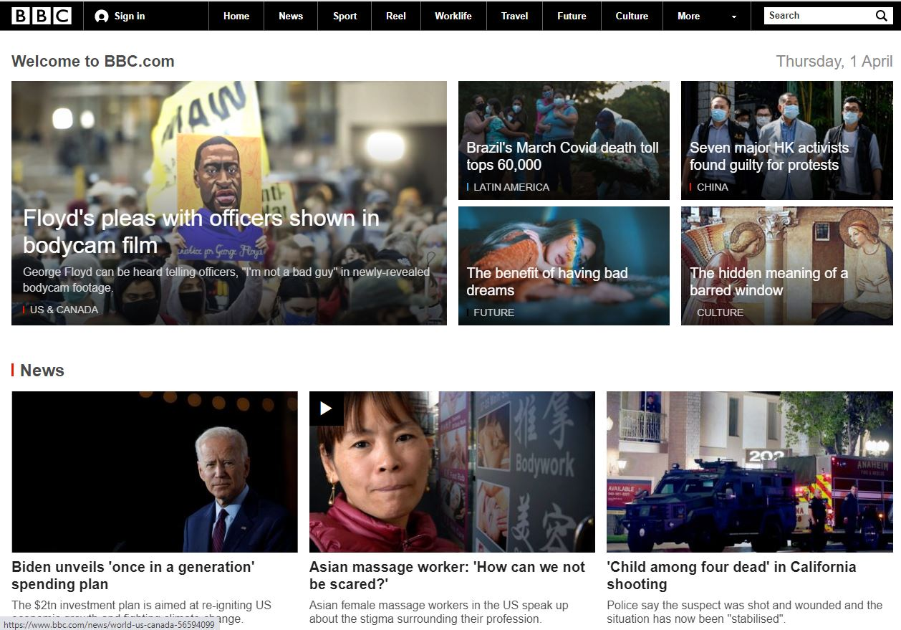
BBC News Web Site

Slide 21
END

